Slide 1
Chapter 8
Sorting in Linear Time
Sun-Yuan Hsieh
謝孫源 教授
成功大學資訊工程學系

Slide 2

Lower bounds for sorting
Lower bounds
Ω(n) to examine all the input.
All sorts seen so far are Ω(n lg n).
We’ll show that Ω(n lg n) is a lower bound for comparison sorts.

Slide 3


Decision tree
Abstraction of any comparison sort.
Represents comparisons made by
  a specific sorting algorithm
  on inputs of a given size.
Abstracts away everything else: control and data movement.
We’re counting only comparisons.

Slide 4
For insertion sort on 3 elements:
[Each internal node is labeled by indices of array elements from their original
positions. Each leaf is labeled by the permutation of orders that the algorithm
determines.]
compare A[1] ＞A[2]
A[1] ≦A[2]
1:2
A[1] ＞A[2] (swap in array)
≦
＞
2:3
A[1] ≦A[2]
A[2] ＞A[3]
1:3
A[1] ＞A[2]
A[1] ＞A[3]
≦
＞
≦
＞
<1,2,3>
1:3
<2,1,3>
2:3
≦
＞
≦
＞
A[1] ≦A[2] ≦A[3]
<1,3,2>
<3,1,2>
<2,3,1>
<3,2,1>

Slide 5
How many leaves on the decision tree? There are ≧ n! leaves, because every permutation appears at least once.
For any comparison sort,
1 tree for each n.
View the tree as if the algorithm splits in two at each node, based on the information it has determined up to that point.
The tree models all possible execution traces.

Slide 6
What is the length of the longest path from root to leaf ?
Depends on the algorithm
Insertion sort: Θ(n²)
Merge sort: Θ( n lg n)

Slide 7
Lemma
Any binary tree of height h has ≦ 2^{h} leaves.
In other words:
l = # of leaves,
h = height,
Then l ≦ 2^{h}.

Slide 8
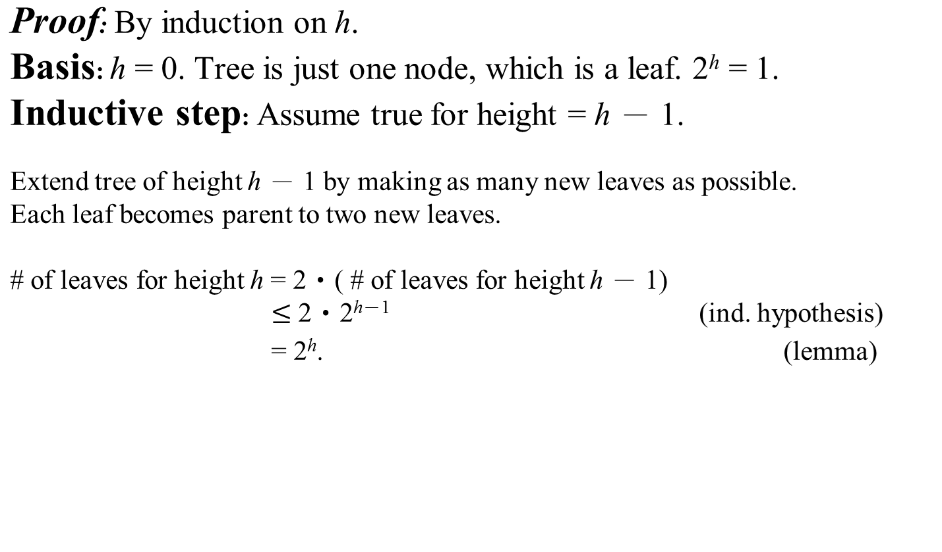

Slide 9
Theorem. Any decision tree that sorts n elements has height Ω(nlgn)
Proof
l ≧ n!
By lemma, n! ≦ l ≦ 2^{h} or 2^{h} ≧ n!
Take logs: h ≧ lg(n!)
Use Stirling’s approximation: n! ＞ (n/e)^{n} (by equation (3.16))
h ≧ lg(n/e)^{n}
= n lg(n/e)
= n lg n － n lg e
= Ω( n lg n) (theorem)
(e = Euler's number ≈ 2.71828)

Slide 10
Corollary
Heapsort and merge sort are asymptotically optimal comparison sort.

Slide 11

Sorting in linear time
Non-comparison sorts.
Counting sort
Depends on a key assumption: numbers to be sorted are integers in {0, 1, …, k}.
Input: A[1..n], where A[j] {0, 1, …, k} for j = 1, 2, …, n. Array A and values n and k are given as parameters.
Output: B[1..n], sorted. B is assumed to be already allocated and is given as a parameter.
Auxiliary storage: C[0…k]

Slide 12
COUNTING-SORT(A, B, n, k)
for i ← 0 to k
do C[i] ← 0
for j ← 1 to n
do C[A[j]] ← C[A[j]] + 1
for i ← 1 to k
do C[i] ← C[i] + C[i － 1]
for j ← n downto 1
do B[C[A[j]]] ← A[j]
C[A[j]] ← C[A[j]] － 1

Slide 13
Do an example for A = 2₁, 5₁, 3₁, 0₁, 2₂, 3₂, 0₂, 3₃
Counting sort is stable (keys with same value appear in same order in output as they did in input) because of how the last loop works.

Slide 14
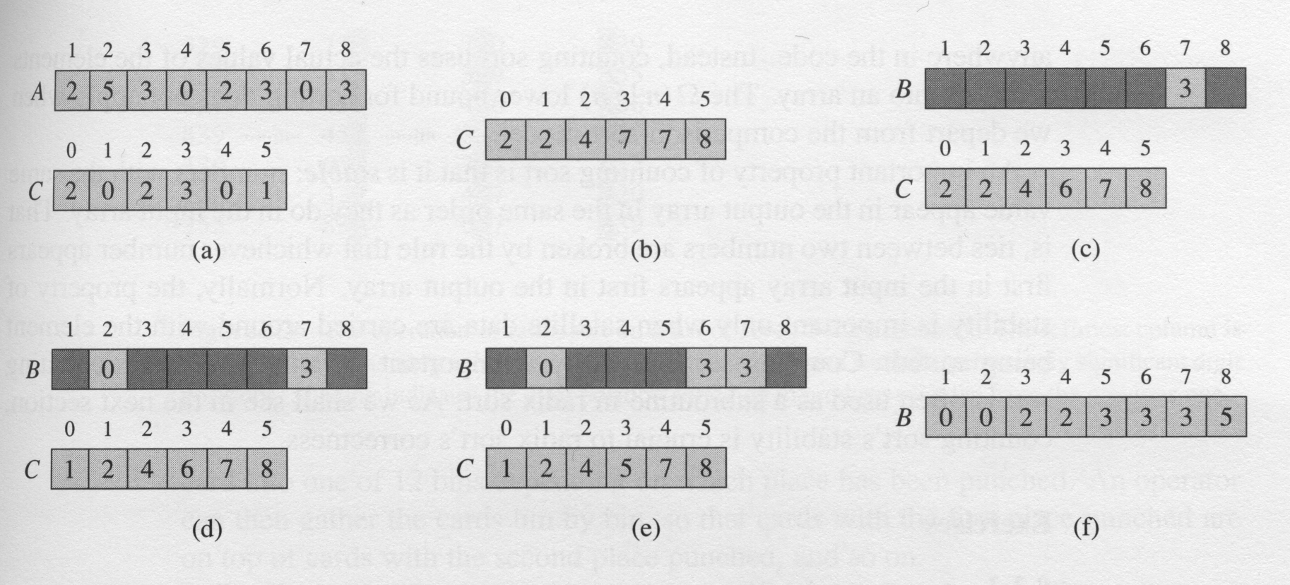
The operation of Counting-sort on an input array A[1…8]

Slide 15
Analysis: Θ(n + k), which is Θ(n) if k = Ο(n).
How big a k is practical?
Good for sorting 32-bit values? No.
16-bit? Probably not.
8-bit? Maybe, depending on n.
4-bit? Probably (unless n is really small).
Counting sort will be used in radix sort.

Slide 16
Radix sort
Key idea: Sort least significant digits first.
To sort d digits:
RADIX-SORT(A, d)
for i ← 1 to d
do use a stable sort to sort array A on digit i

Slide 17
Example:
sorted
326
453
608
835
751
435
704
690
690
751
453
704
835
435
326
608
704
608
326
835
435
751
453
690
326
435
453
608
690
704
751
835

Slide 18

Correctness:
Induction on number of passes (i in pseudocode).
Assume digits 1, 2, …, i － 1 are sorted.
Show that a stable sort on digit i leaves digits 1,…, i sorted:
  If 2 digits in position i are different, ordering by position i is correct, and positions 1, …, i － 1 are irrelevant.
  If 2 digits in position i are equal, numbers are already in the right order (by inductive hypothesis). The stable sort on digit i leaves them in the right order.
This argument shows why it’s so important to use a stable sort for
intermediate sort.

Slide 19
Analysis: Assume that we use counting sort as the intermediate sort.
Θ(n + k) per pass (digits in range 0, …, k)
d passes
Θ(d(n + k)) total
If k = Ο(n), time = Θ(dn).

Slide 20
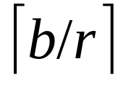

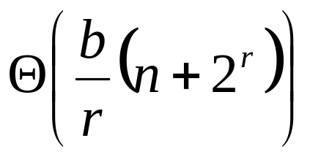
How to break each key into digits?
n words
b bits/word
Break into r-bit digits. Have d =
Use counting sort, k = 2^{r} － 1
Example: 32-bit words, 8-bit digits. b=32, r=8, d=
=4, k=2⁸－1= 255
Time =

Slide 21

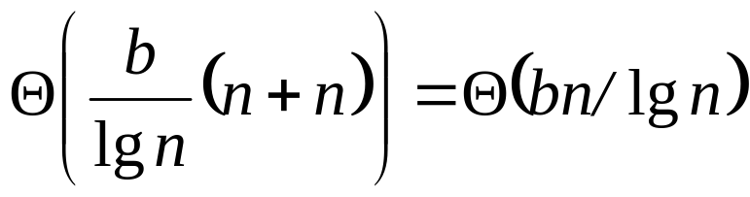

How to choose r? Balance b/r and n + 2^{r}. Choosing r lg n gives us
If we choose r ＜ lg n, then b/r ＞ b/lg n, and n + 2^{r} term doesn’t improve.
If we choose r ＞ lg n, then n + 2^{r} term gets big. Example:
r = 2 lg n 2^{r} = 2^{2 lg n} = (2^{lg n})² = n².
So, to sort 2¹⁶ 32-bit numbers, use r = lg 2¹⁶ = 16 bit. = 2 passes.

Slide 22

Compare radix sort to merge sort and quicksort:
1 million (2²⁰) 32-bit integers.
Radix sort: = 2 passes.
Merge sort/quicksort: lg n = 20 passes.
Remember, though, that each radix sort “pass” is really 2 passes–one to take census, and one to move data.
How does radix sort violate the ground rules for a comparison sort?
Using counting sort allows us to gain information about keys by means other than directly comparing 2 keys.
Used keys as array indices.

Slide 23
Bucket sort
Assumes the input is generated by a random process that distributes elements uniformly over [0, 1).
Idea:
Divide [0, 1) into n equal-sized buckets.
Distribute the n input values into the buckets.
Sort each bucket.
Then go through buckets in order, listing elements in each one.

Slide 24

Input: A[1..n], where 0 ≦ A[i] ＜ 1 for all i.
Auxiliary array: B[0..n－ 1] of linked lists, each list initially empty.
BUCKET-SORT(A, n)
for i ← 1 to n
do insert A[i] into list B
for i ← 0 to n － 1
do sort list B[i] with insertion sort
concatenate lists B[0], B[1], …, B[n－ 1] together in order
return the concatenated lists

Slide 25
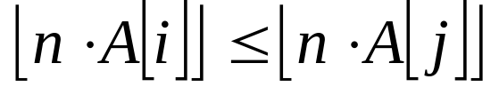
Correctness: Consider A[i], A[j]. Assume without loss of generality that A[i] ≦ A[j]. Then . So A[i] is placed into the same bucket as A[j] or into a bucket with a lower index.
If same bucket, insertion sort fixes up.
If earlier bucket, concatenation of lists fixes up.

Slide 26
Analysis:
Relies on no bucket getting too many values.
All lines of algorithm except insertion sorting take Θ(n) altogether.
Intuitively, if each bucket gets a constant number of elements, it takes Ο(1) time to sort each bucket Ο(n) sort time for all buckets.
We “expect” each bucket to have few elements, since the average is 1 element per bucket.
But we need to do a careful analysis.

Slide 27
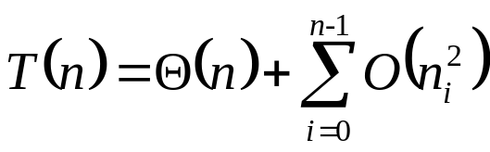
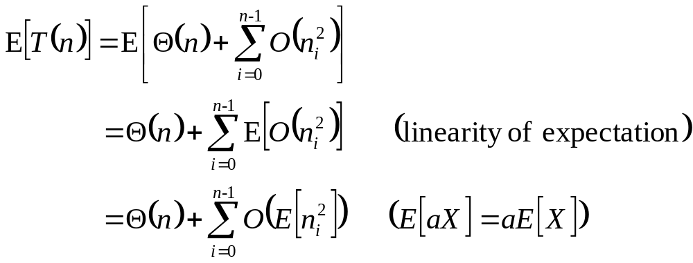
Define a random variable:
n_{i} = the number of elements placed in bucket B[i].
Because insertion sort runs in quadratic time, bucket sort time is
Take expectations of both sides:

Slide 28
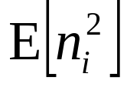
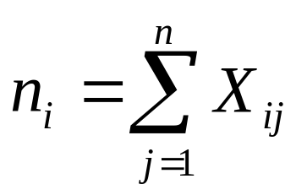
Claim
= 2 － (1/n) for i = 0, …, n － 1.
Proof of claim
Define indicator random variables:
X_{ij} = I{A[j] falls in bucket i}
Pr{A[j] falls in bucket i} = 1/n

Slide 29
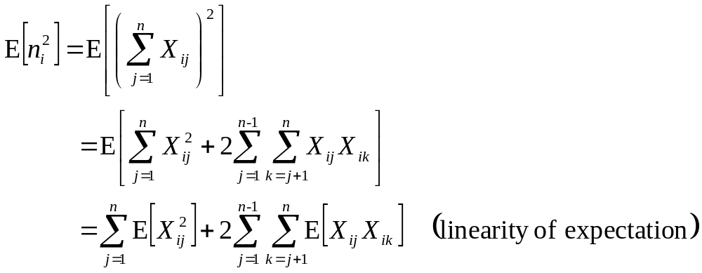
Then

Slide 30
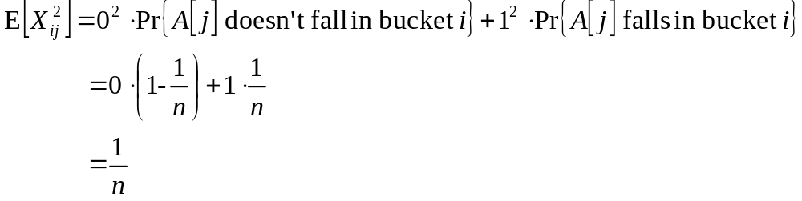
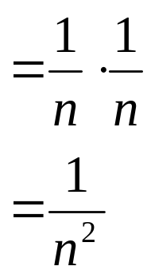
E[X_{ij}X_{ik}] for j ≠ k: Since j ≠ k, X_{ij} and X_{ik} are independent random variables
E[X_{ij}X_{ik}] = E[X_{ij}]E[X_{ik}]

Slide 31
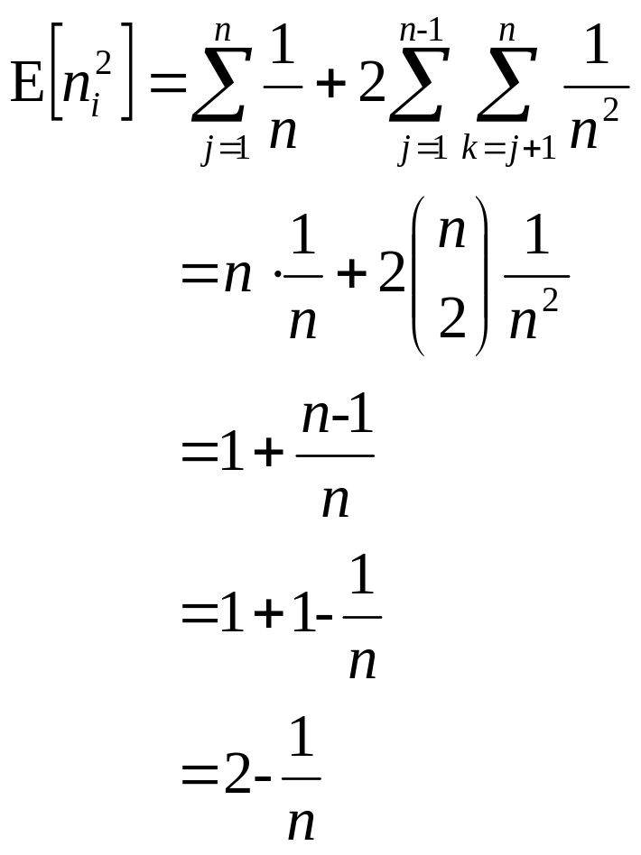
Therefore:
(claim)

Slide 32
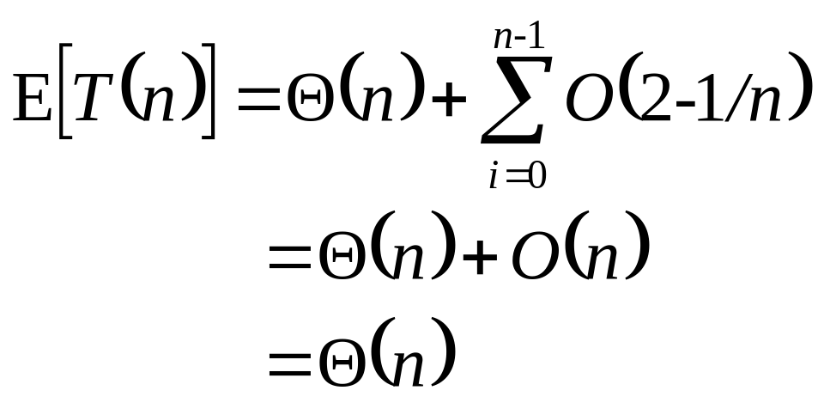
Therefore:

Slide 33
Again, not a comparison sort. Used a function of key values to index into an array.
This is a probabilistic analysis—we used probability to analyze an algorithm whose running time depends on the distribution of inputs.
Different from a randomized algorithm, where we use randomization to impose a distribution.
With bucket sort, if the input isn’t drawn from a uniform distribution on [0,1), all bets are off (performance-wise, but the algorithm is still correct).

